Slide 1
Steam:
Jason Chiu

Slide 2
Outline
Steam
Research Question
Data
Preliminary Findings
Future

Slide 3
Steam
Leading digital distribution platform
Valve Corporation (Game Developing Company: CS and Half Life)
Services
Game purchase/management
Cloud saving
Multiplayer gaming
Social Networking
Mostly for PC games
Limited support for consoles and mobile devices

Slide 4
Gamers
Over 125M active accounts
18% Female and 82% Male
36 Million in the U.S.
~ 60,000 games
Avg. 40.5 games/user
U.S. accounts for 24.70% of all game sales
20 Million in game sales/month

Slide 5
Research Question
Game
A structure form of play with a goal
Interact or compete with other players/AIs
Voluntary participation
Research Question:
There are 60,000 games on steam - what makes people pick one over another?
What are some of the factors associated with the number of players that play a game?

Slide 6
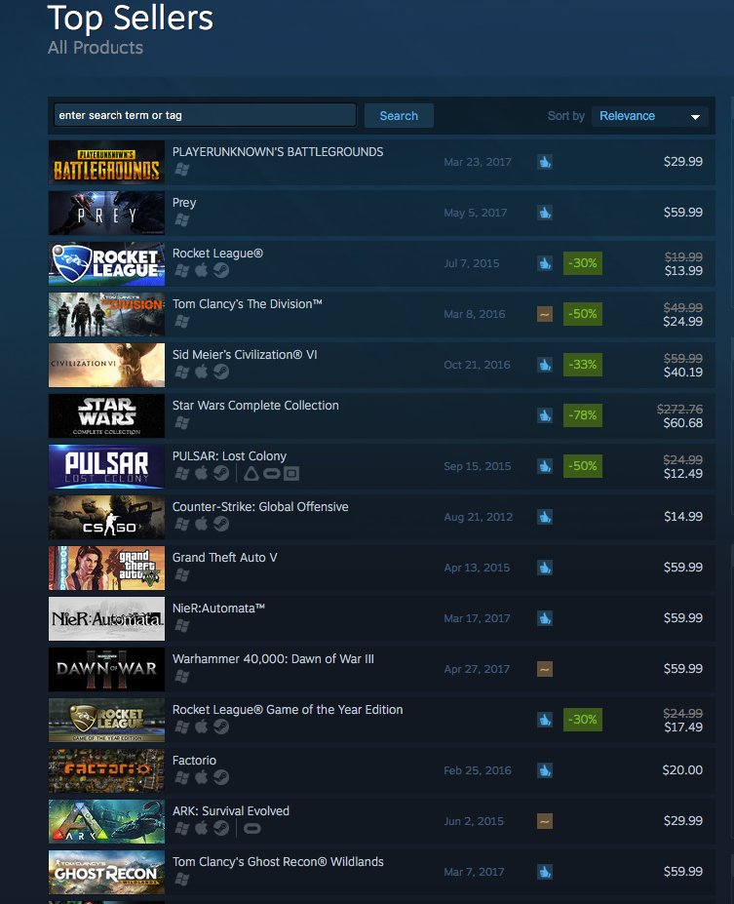

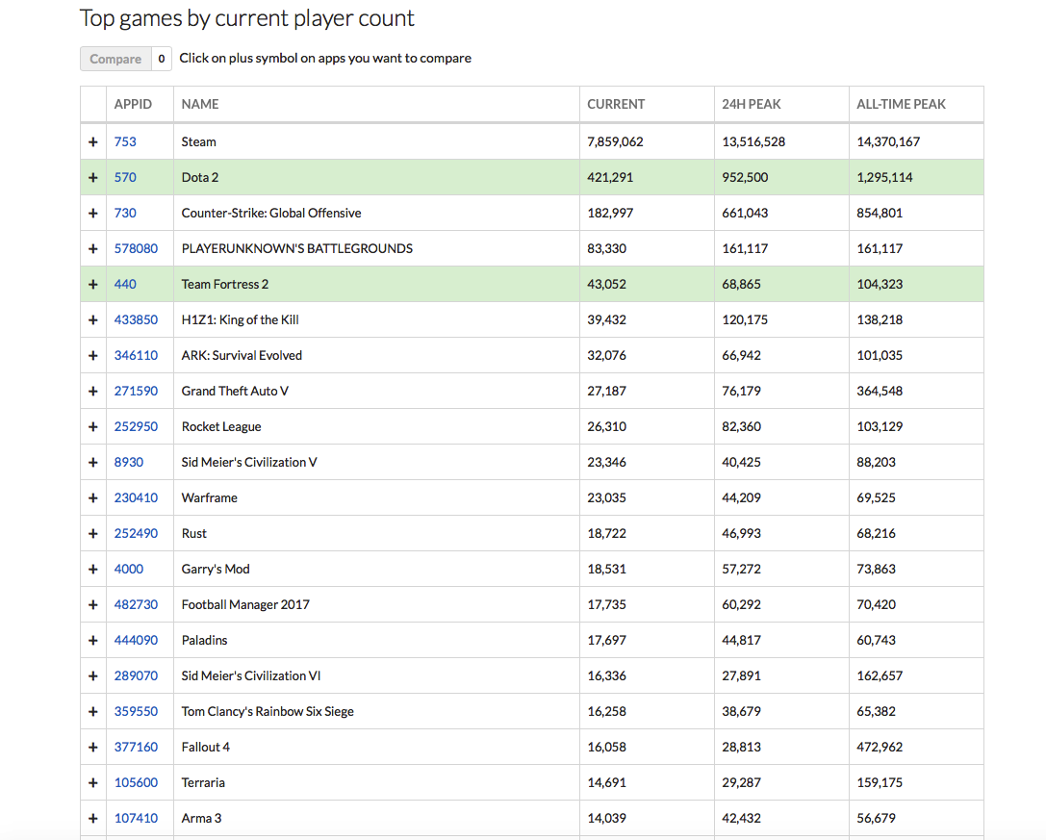
Data Scraping - Selenium and Scrapy
Steam Top Sellers
7641 games (51 pages)
Steam Game Page
6902 games
Steamdb.info
8061 games

Slide 7
Data
2600 DLCs/soundtracks – combined with original game
Dummy coded the top genres and user-defined keywrods
A total of 3080 games were included

